Slide 1
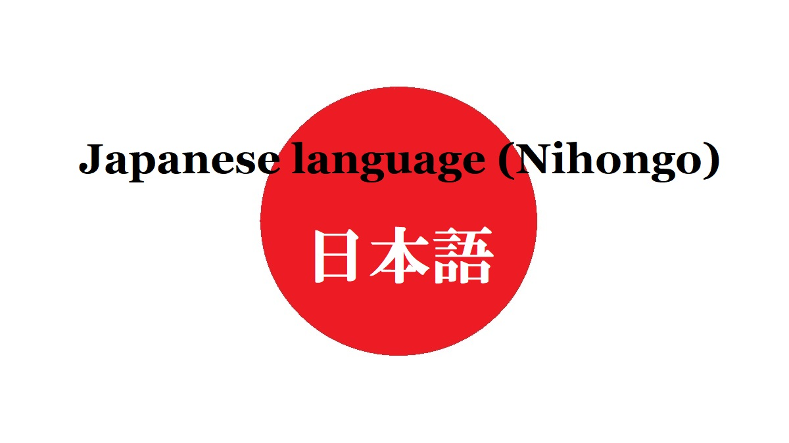
Dive Deeper into Japanese Language
-Particle 'で'(/de/)-
Composed By: Hayato Ishida
For Japanese version, click here
Updated On: 16 July 2024

Slide 2

About Me
Accounts
GitHub: @hayat01sh1da
X: @hayat01sh1da
LinkedIn: @hayat01sh1da
Speaker Deck: @hayat01sh1da
Docswell: @hayat01sh1da
Occupation: Software Engineer
Things I Am Into
Linguistics
Singing at Karaoke
Listening to Music
Watching Movies
Cat Feeding

Slide 3
Licences / Certifications
English
TOEIC® Listening & Reading 915: Certified on December 2019
Engineering
Information Security Management: Certified on November 2017
Applied Information Technology Engineer: Certified on June 2017
Fundamental Information Technology Engineer: Certified on November 2016
IT Passport: Certified on April 2016
Others
Abacus 2nd Class: Certified on June 2002
Mental Arithmetic 3rd Class: Certified on February 2001

Slide 4
Skill Stack
Languages
Japanese: Native Proficiency
English: Full professional Proficiency
Development
Backend: Ruby(Ruby on Rails), Python
Frontend: TypeScript + React.js, TypeScript +Vue.js
Database: MySQL, PostgreSQL, MongoDB
Architecture: Monolith, Modular Monolith
Hosting: AWS ESK
Versioning: Git, GitHub
CI/CD: GitHub Actions, ArgoCD
Monitoring: Datadog, Sentry

Slide 5
Work Histories
Period | Genre | Position | Jobs
Aug 2021 - Present | Saas(Educational Service) | Software Engineer | Backend Development Frontend Development CI/CD Maintenance Weekly Release Manager Troubleshooting Documentation Technical Debt Resolution Tech Blog Entries LT Speaker
Feb 2020 - Dec 2020 | SaaS(Chatbot Platform) | Backend Engineer | Backend Development Documentation Technical Debt Resolution Inspection of Alternative API

Slide 6
Work Histories
Period | Genre | Position | Jobs
Jun 2018 - Jan 2020 | Contract-basis Developer | Software Engineer | Backend Development Frontend Development Troubleshooting Quality Assurance Tech Blog Entries
Apr 2016 - Jan 2018 | System Engineering Service | System Engineer | Corporate Account Admin Windows Server Maintenance Security Admin Assistant Internationalisation / Localisation

Slide 7
International-Exchange Activities
Activities in University
English Linguistics Seminar(Focusing on Mass Media English)
International-Exchange Clubs(The 2nd Year)
International-Exchange Programmes conducted by Japan Cabinet Office(2013 - 2016)
Japanese Linguistics Course(The Final Year)
Overseas Life Experience
Working Holiday in Australia(April 2014 - March 2015)
Language School for 1 month in Sydney
Work for 6 Months in Hamilton Island Resort
Volunteering for 1 Month as Assistant Teacher of Japanese Language at St Ives High School in NSW
Other Activities
Keep Everyday Journal in English (April 2014 - Present)
Sunrise Toastmasters Club(February 2017 - March 2018)
Vital Japan(January 2018 - July 2019, October 2022 - February 2023)
Self Learning and Training of English Language
Participation Ruby-Related Tech Conferences

Slide 8
Agenda
The Main Theme
Prologue -で of みんなで-
Cognitive Linguistical Analysis 1 -Spatial Functions-
Cognitive Linguistical Analysis 2 -Role Functions-
True Identity of で of みんなで
Summary
Epilogue
References

Slide 9
1. The Main Theme

Slide 10
1. The Main Theme
When I grammatically analyse a Japanese particle, it turned out that it was a lot more difficult than English grammar.
I will discuss how profound it is and share as easy a description as possible.

Slide 11
2. Prologue -で of みんなで-

Slide 12
2. Prologue -で of みんなで-
I worked as an assistant teacher of Japanese language at St Ives High School in NSW on February 2015 for a month.
One day, a student ask me the following .
I'd like to ask you about a Japanese particle. If I say, "I will pick you up at the airport with everyone tomorrow." in Japanese, it is supposed to be 明日空港にみ んなであなたを迎えに行きます, but I don't understand why I have to use で, instead of はor がthough みんな seems the subject in this sentence. Would you explain why?

Slide 13
2. Prologue -で of みんなで-
Summary of the Provided Question
みんな(everyone) is the actor of 迎えに行く(to pick you up), so みんな is supposed to be the subject in the Japanese sentence.
Notwithstanding, the actual subject is absent in the original sentence andみんな plays a role in a modifier. Why is it followed by で, not は(topic marker) or が (subject marker).

Slide 14
2. Prologue -で of みんなで-
I thought the question hit the mark, but I was not sure of the answer at all.
As an assistant teacher, I was ashamed of my ignorance and provided the following response.
I'm sorry but I'm not sure of the details. I'm afraid it is because of its collocation.

Slide 15
2. Prologue -で of みんなで-
As soon as I returned home, I looked up で in the 5th version of Kojien Japanese Dictionary,
which showed me the following definitions.
Place・Time・Occasion where an action is taken
Means・Way・Tool・Material
Reason・Cause
Scene
Status・Qualification
Affair・Condition
Period・Range
Standard of distribution

Slide 16
2. Prologue -で of みんなで-
There was NO ANSWER I was looking for!

Slide 17
2. Prologue -で of みんなで-
After all, I brought the question back to my home country.
I returned to university and took a Japanese linguistics class in the autumn semester, where I submitted a term paper whose theme was The Role and Grammatical Structure of the Japanese Particle で.
I made sense of the profound riddle and won the S credit.
It would be happy if I may share as clear explanations of what I learned as possible.

Slide 18
3. Cognitive Linguistical Analysis 1 -Spatial Functions-

Slide 19
3. Cognitive Linguistical Analysis 1 -Spatial Functions-
3-1. Place → <Place Abstraction> → Occasion
Place
2004年のオリンピックはアテネで開かれた。
The 2004 Olympic Games were held in Athens.
It represents the visible object Athens.
Occasion
彼は自然に恵まれた環境で育った。
He was raised in a region richly endowed with nature.
It represents the invisible object nature.

Slide 20
3. Cognitive Linguistical Analysis 1 -Spatial Functions-
3-2. Place → <Focus on Scope・Subjection of Action> → Scope
彼はこのクラスで 1 番背が高い。
He is tallest (of all students) in this class.
The concreate place this class has been transformed to the usage of limitation of the
subjective scope.
The usage has finally expanded to the objective scope this class where he is searched for.

Slide 21
3. Cognitive Linguistical Analysis 1 -Spatial Functions-
3-3. Place → <Backgrounding of Place> → Actor
その事件は警察で調べている。
The case is being examined by the police.
Police is a group of police officers and it has turned to backgrounding of a place, which
finally has been transformed to the place where the actor police is closely concerned.
Subject(the case) ≠ Actor(the police)

Slide 22
3. Cognitive Linguistical Analysis 1 -Spatial Functions-
3-4. Place → <Metaphor> → <Focus on Time Scope>→ Limitation of Timing
食事の後で勉強する。(Someone will study just after a meal.)
After a meal has changed from space of place to that of time.
This usage represents time and space as a scene where an action is taken, so it lays
more emphasis on limitation the scope of time.
食事の後に勉強する。(Someone will study after a meal.)
It also represents limitation of the scope of timing, but it does not mention a place.
On the other hand, で has a more specific usage as limitation of time and space.

Slide 23
4. Cognitive Linguistical Analysis 2 -Role Functions-

Slide 24
4. Cognitive Linguistical Analysis 2 -Role Functions-
4-1. Place → <Role of Background> → <Internalised Tools・Means> →
Material・Component
Tools and Means
日本人は箸で食事をする。
Japanese people (usually) have a meal with chopsticks.
It represents a concrete and individual place where pressure is put.
Material or Component
この机は木でできている。
This desk is made of wood.
It represents a inclusive place which is less individual and more subject to something else.

Slide 25
4. Cognitive Linguistical Analysis 2 -Role Functions-
4-2. Tool → <Active Backgrounding> → Cause → Reason・Argument・Purpose・Component
Cause
病気で学校を休む。(Someone is absent from school with illness.)
The relation between the cause and result is more highly objective.
Reason
そういう点で面白いと思う。(It is interesting in the sense.)
Argument
試験の結果で判断する。(Something is judge from the result of examination.)
Purpose
出張で大阪へ行ってきた。(Someone went to Osaka as a business trip.)
The recognition of the incident depends on the person, so it is subjective.
Component
日本の文化というテーマで論文を書いた。(Someone wrote a paper whose theme is Japanese culture.)
It represents a component consisting of something, so it implies a cause, tool and material.

Slide 26
4. Cognitive Linguistical Analysis 2 -Role Functions-
4-3. Tool → <Abstraction of Tool> → Mode
All of the following usages represent an internalised or recursive tool.
Mode of Actor
食事は自分で作っている。(I make a meal by myself.)
It represents the mode of the actor who makes a meal by themselves with oneself as a recursive tool.
Subject(I) = Actor(I)
Mode of Receiver
小さい音で音楽を聴く。(Someone listens to music in a low volume.)
It represents the mode of the receiver of sound of music as an internal tool.
Mode of Influence・Incident
猛スピードで走っている。(Something is running at a high speed.)
It represents the internal tool of a high speed making something run.
数量限定
この部屋は 30 人でいっぱいになる。(This room is full up with 30 people.)
It represents the external tool of 30 people filling up the room.

Slide 27
5. True Identity of で of みんなで

Slide 28
5. True Identity of で of みんなで
「明日空港にみんなであなたを迎えに行きます。 」
で in the above has in either of the following usages.
Actor in Spatial Functions: その事件は警察で調べている。(The case is being examine by the
police.)
Mode of Actor in Role Functions: 食事は自分で作っている。(I make a meal by myself.)
The key difference is the equality of the relation between the subject and the actor.

Slide 29
5. True Identity of で of みんなで
To supplement the omitted subjects, each sentence is supposed to be as follows.
「(私は)明日空港にみんなであなたを迎えに行きます。」
I will pick you up at the airport with everyone.
→ Subject(I) ≠ Actor(everyone)
Actor in Spatial Functions: 「その事件は警察で調べている。」
The case is being examined by the police.
→ Subject(The case) ≠ Actor(the police)
Mode of Actor in Role Functions: 「 (私は)食事は自分で作っている。」
I make a meal by myself.
→ Subject(I) = Actor(myself)
The true identity of で of みんなで is the Mode of Actor in Role Functions.
※ If the subject is 私たち(we) instead of 私(I), the equality of the relation between the subject(we) and Actor(everyone = us) makes sense, which represents the Mode of Actor in Role Functions.

Slide 30
6. Summary

Slide 31
6. Summary
'で' has the following 2 cognitive linguistic functions as follows.
Spatial Functions
Place → <Place Abstraction> → Occasion
Place → <Focus on Scope・Subjection of Action> → Scope
Place → <Backgrounding of Place> → Actor
Place → <Metaphor> → <Focus on Time Scope>→ Limitation of Timing
Role Functions
Place → <Role of Background> → <Internalised Tools・Means> → Material・Component
Tool → <Active Backgrounding> → Cause → Reason・Argument・Purpose・Component
Tool → <Abstraction of Tool> → Mode

Slide 32
7. Epilogue

Slide 33
7. Epilogue
One of the key differences between Japanese language and English language is the existence of particle.
Proposition follows a word in English while particle is followed by a word in Japanese.
Just as learners of English language think of nuances of propositions of English as highly difficult, those of Japanese language see usage of particles as magnificently profound.
For native Japanese speakers, they will find how difficult it is once they observe it from the point of view as a foreign language.
A Japanese particle was a good example.

Slide 34
8. References

Slide 35
8. References
Shin Moriyama, 認知言語学から見た日本語格助詞の意味構造と習得, Tokyo, ひつじ書房, 2008
広辞苑第五版, Tokyo, 岩波書店, 2006

Slide 36
EOD

